Slide 1

Medical Expert System
Group Members :
Prasann Patel - 100833325
Samarth Patel - 100827936
Shail Patel - 100846377
Tejas Devani - 100846988

Slide 2
Introduction
To let users know about a disease which they suffer, we came up with the idea to develop an expert system which is named Medical Expert System
This system can be used for diagnosing respiratory diseases, and also can be used for detecting illnesses like flu or cold

Slide 3
Task and Purpose of the Expert System
Medical Expert Systems have come into existence to assist Physicians and Patients in the diagnosis and treatment of diseases and even to send alerts and provide notifications
Information technology and clinical knowledge are then intended to improve healthcare safety, efficiency and reliability through their synergy
The fact that Healthcare is a sensitive and constantly evolving field, requires the expert system to be updated, expanded or modified in line with the changing knowledge base and the rules

Slide 4
Knowledge Sources and Knowledge Acquisition
Domain knowledge is vital for any knowledge based expert system
The process of acquiring knowledge involves a human expert, a group of experts, interviews, internet sources or books.
We explored the internet sources such as various government resources and any healthcare web resources to gather common symptoms of cold and flu.

Slide 5
Knowledge Sources and Knowledge Acquisition
https://lunghealth.ca/lung-disease/a-to-z/common-cold/
https://lunghealth.ca/lung-disease/a-to-z/flu/?
https://www.cdc.gov/flu/symptoms/symptoms.htm
https://www.cdc.gov/features/rhinoviruses/index.html
https://github.com/Victor-Titan/Medical-Diagnosis-Expert-System

Slide 6
Knowledge Design and Engineering
Knowledge base - A declarative representation of the expertise, can either be the IF-THEN rules based or knowledge base representation such as semantic net and frame based representation
Inference engine - It is the core of the system, which derives recommendations from the knowledge base and problem-specific data in working memory
Working memory - It is used to store user inputs and for further matching queries, which help to not ask duplicate questions
User interface - It is the interface that controls the interaction between the user and the core expert system

Slide 7
Knowledge Structure
The knowledge construction was built on a concept of rules that were performed in a hierarchical tree structure.
This system has its own internal rule format with header information and all premises are connected by AND or OR conditions.
The rule can be nested, which means a rule can have nested sub-goal rules and different facts.

Slide 8
Inference Engine
combine certainty factors as indicated previously
maintain working memory that is updated as new evidence is acquired
locate all information specific to an attribute when it is asked for, and store that information in working memory

Slide 9
Backward chaining approach
Find
Find rules that match the goal
Stop
If antecedents match the facts, stop
Make
If not, make the antecedents the new sub-goals, and repeat

Slide 10
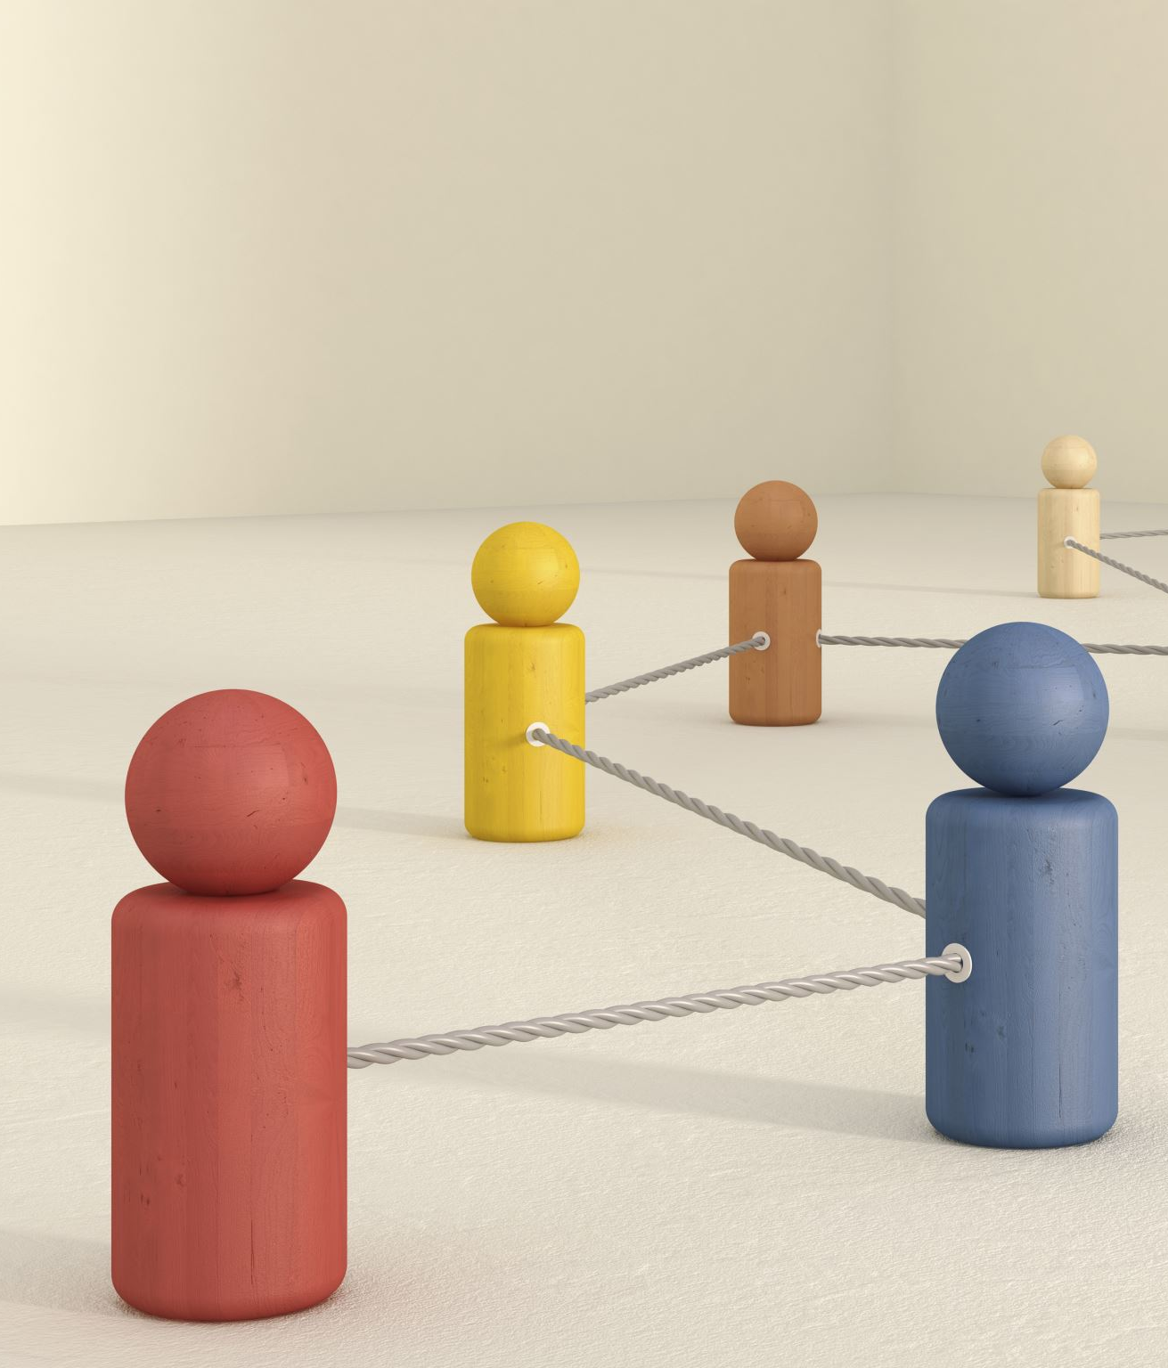
Certainty Factors
Certainty Factors: The most common scheme for modelling uncertainty is to assign a certainty factor to each piece of information in the system
𝐶𝐹 = 𝑅𝑢𝑙𝑒𝐶𝐹 ∗ 𝑃𝑟𝑒𝑚𝑖𝑠𝑒𝐶𝐹

Slide 11
Working memory
One can treat working memory as the brain processes used for temporary storage and manipulation of information
Working memory simply contains the known facts about attribute-value pairs
If a current fact and its certainty fact have been already stored in working memory, the system would not ask users about it further and it will calculate the certainty fact using the stored data

Slide 12
User Interface
The expert system requires users to enter symptoms one by one
The user needs to enter “Diagnose now” to show the diagnosed disease
Users are needed to input their symptoms in their terminal, For Example: If the person is having a fever right now, similarly if the person is suffering from headache, sore throat or any other symptoms, then the user needs to enter those symptoms in the terminal

Slide 13
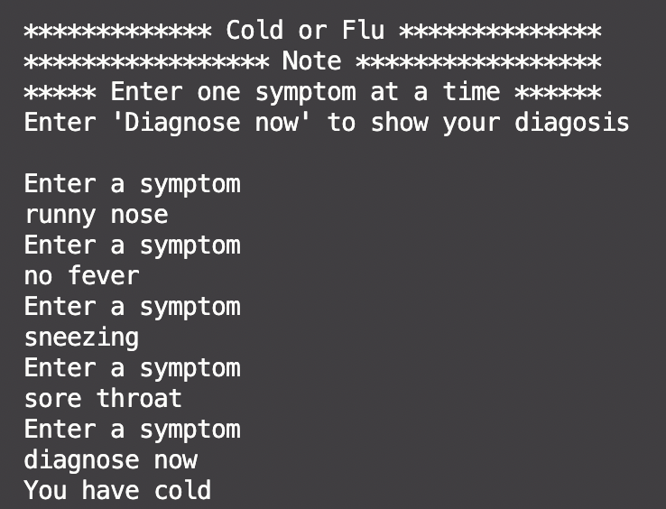
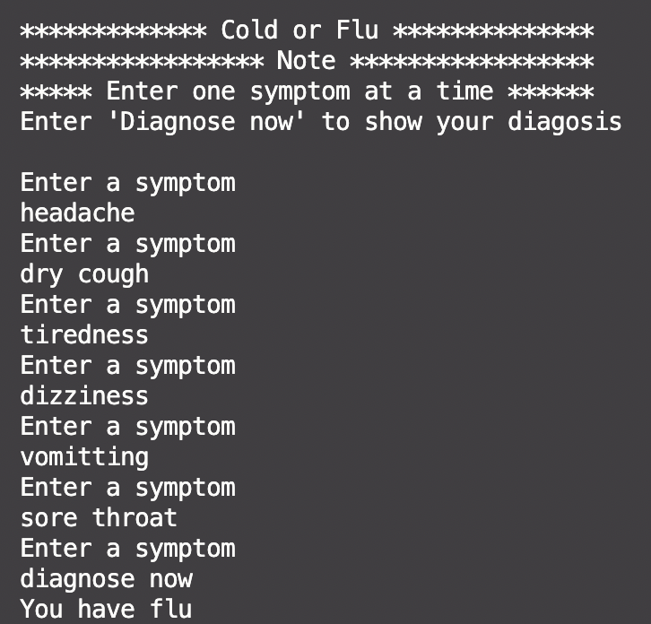
User Interface

Slide 14
Framework and Implementation
To implement the rule-based expert system we have used pyknow library
We implemented an interface engine by defining rules for different symptoms and then we will run the interface engine to make a decision based on predefined rules

Slide 15
Thank You
Github Link: https://github.com/Shail079/Medical-Expert-System

